Slide 1


Mind Sending
Supervisor: - Lam Huu Khanh Phuong
Members: - Ngo Minh Tan - Leader
- Nguyen Huu Thang
- Nguyen Luu Hong Son

Slide 2
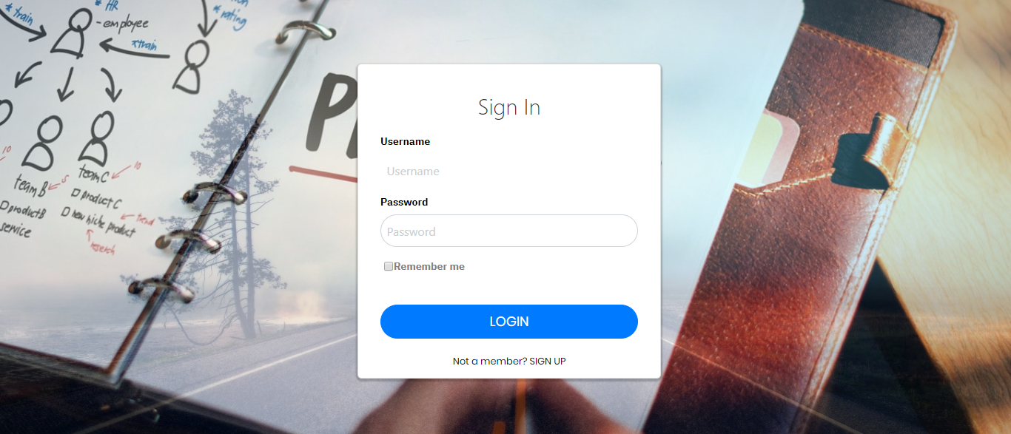
01
Introduction
02
Issues
03
CONTENT
Idea & Solution
04
algorithm
05
Outcome
06
Future Plan
07
Q & A

Slide 3

1. Introduction
What?
Why?
How?

Slide 4
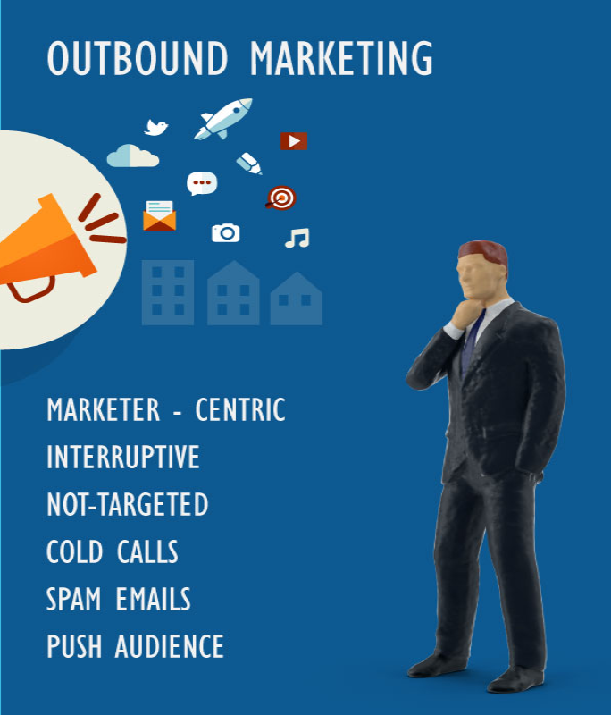
1. Introduction
What?
Why?
How?

Slide 5

1. Introduction
Kiếm hình áp đặt thông tin.

Slide 6
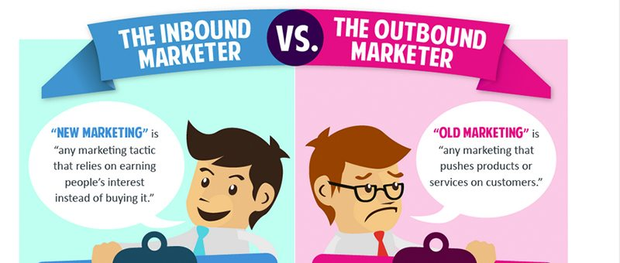

Slide 7
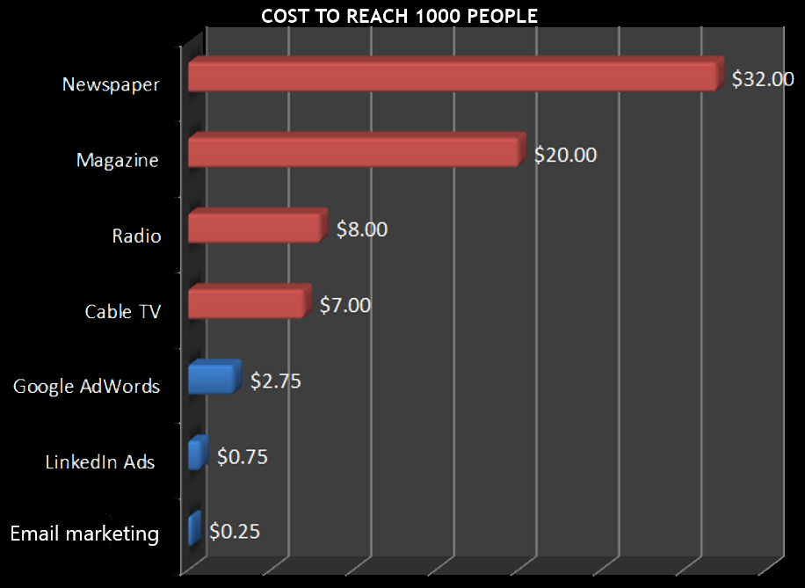
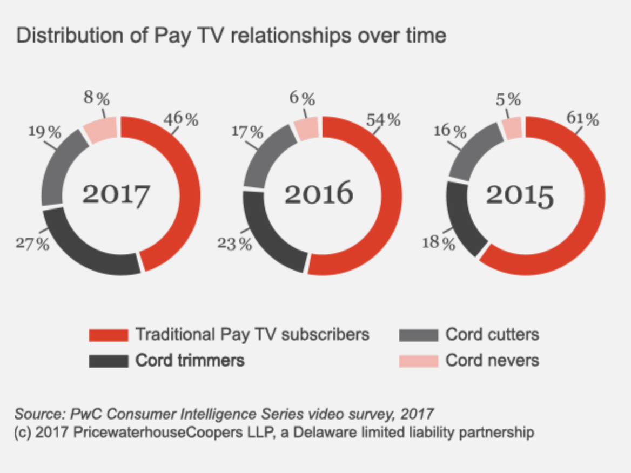
1. Introduction

Slide 8
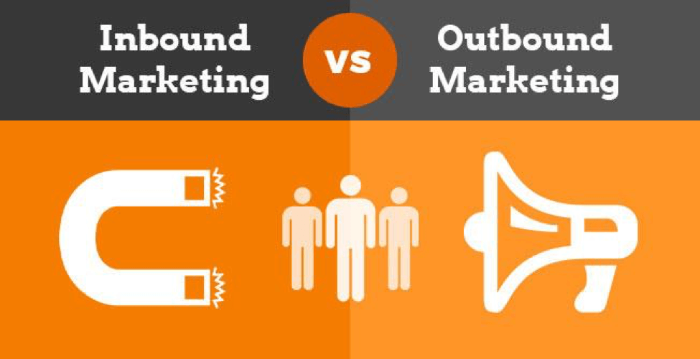
1. Introduction
What?
Why?
How?

Slide 9
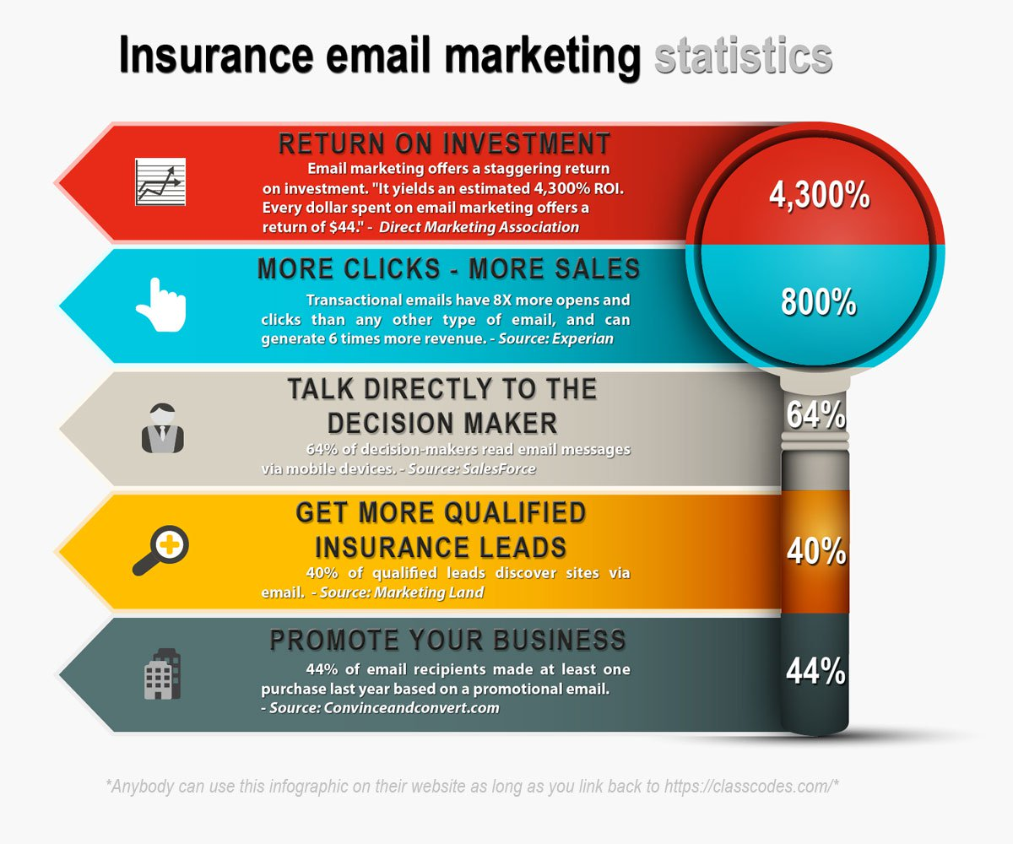
1. Introduction
What?
Why?
How?

Slide 10
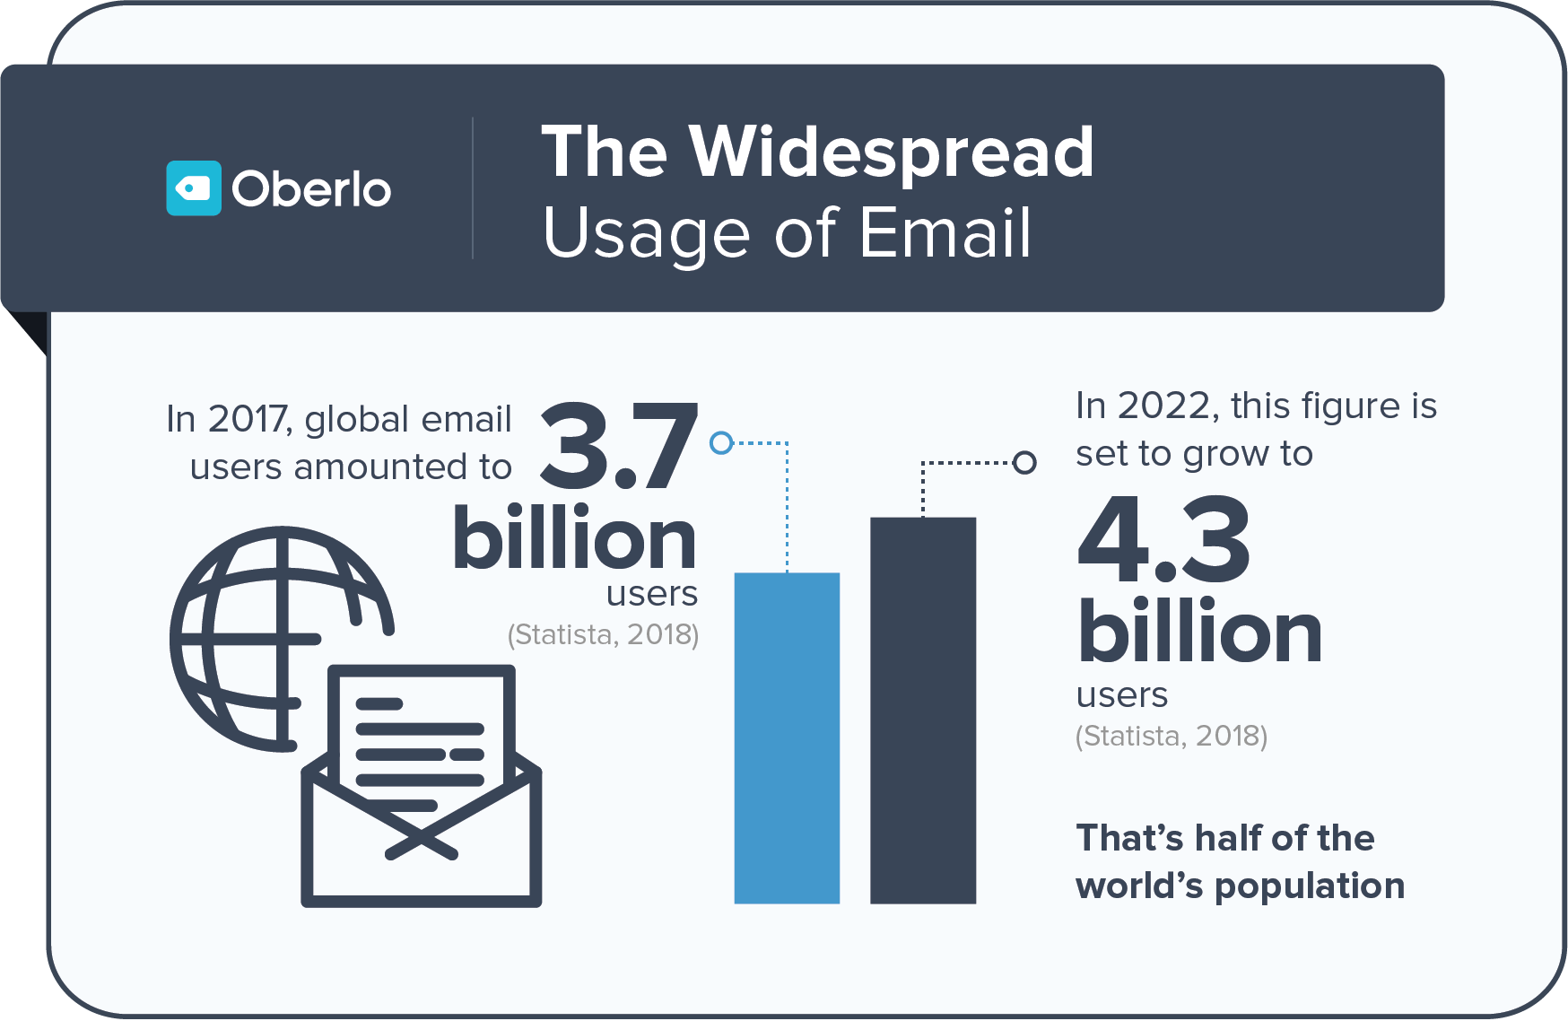
1. Introduction

Slide 11

Email marketing
High success rate

Slide 12

Email marketing
High speed and easy to use

Slide 13

Email marketing
Aim for the right target

Slide 14

Email marketing
Flexibility in design

Slide 15

Email marketing
Increase brand awareness and keep relationships with customers

Slide 16

2. Demo
20

Slide 17

2. Issues
Control big data of contacts
High Spam Rate
High Cost
4. Block Email Sender

Slide 18


Issue
Can not control amount of customers

Slide 19

Issue
Not guarantee user’s mail will be in customer’s inbox

Slide 20

Issue
Block email

Slide 21

Issue
High Cost

Slide 22
2. Issues
Control big data of contacts
High Spam Rate
High Cost
4. Block Email Sender

Slide 23
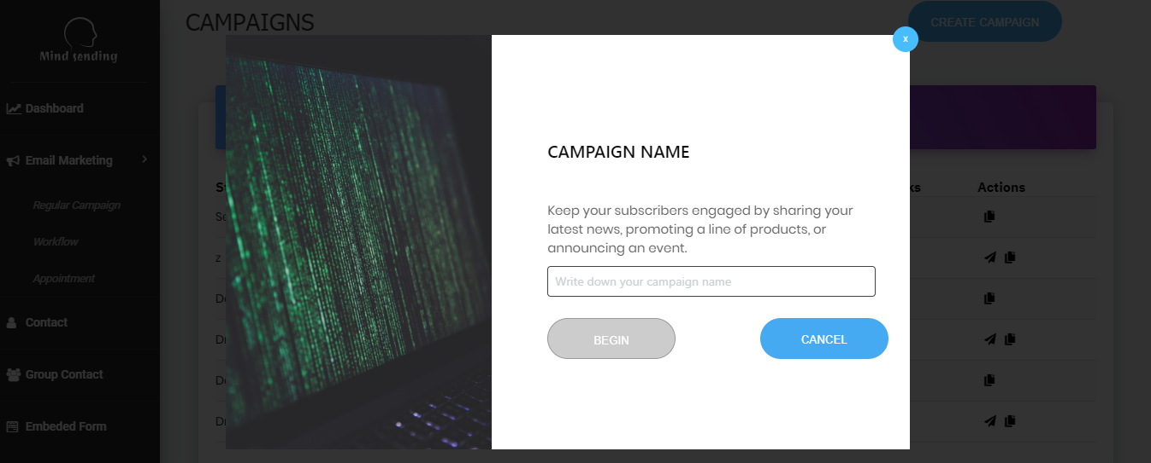
3. Idea & Solution
What?
Why?
How?

Slide 25
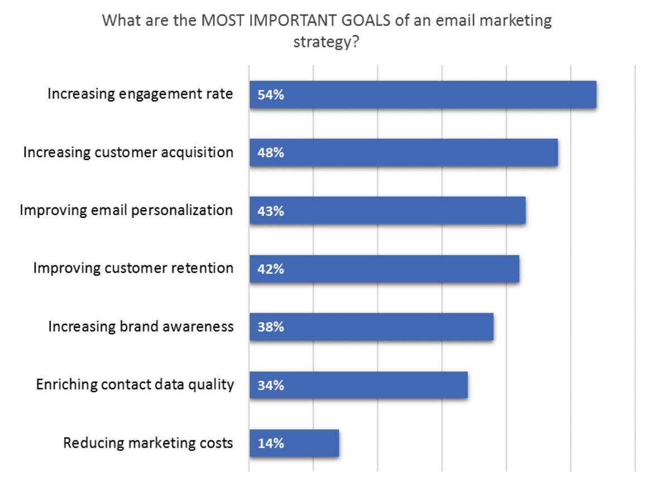
Idea & Solution

Slide 26
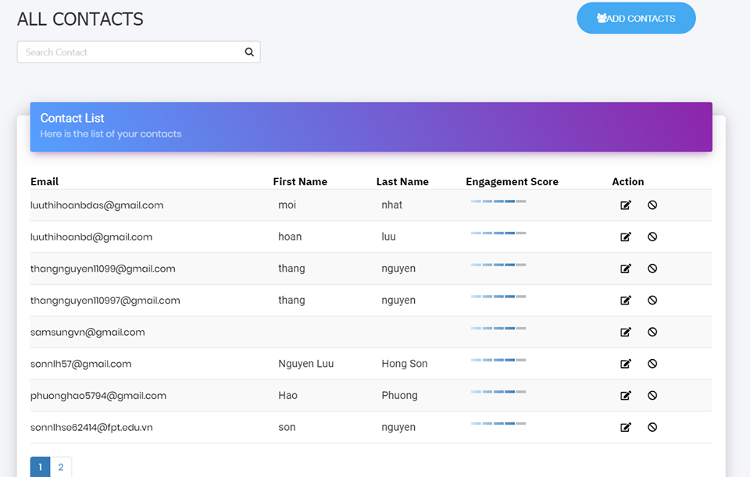
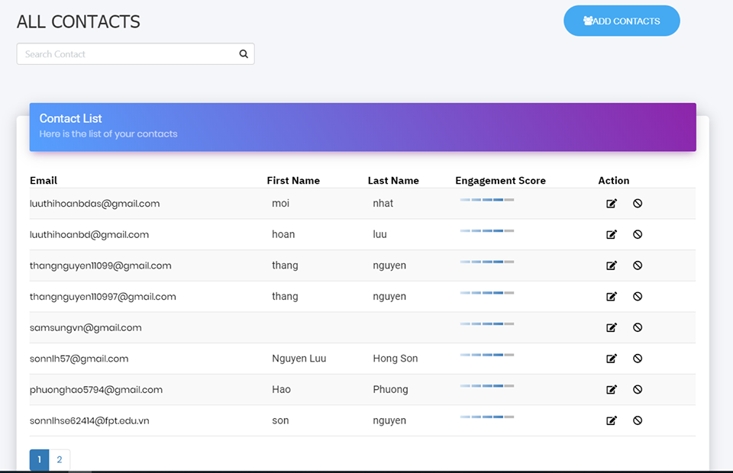
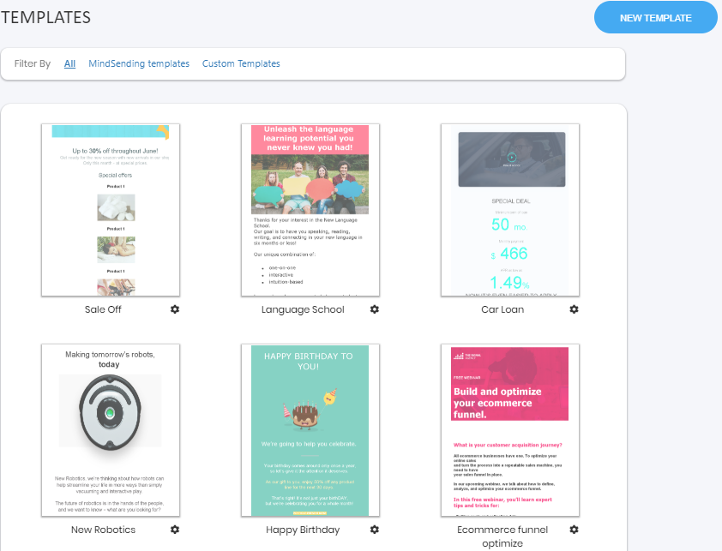
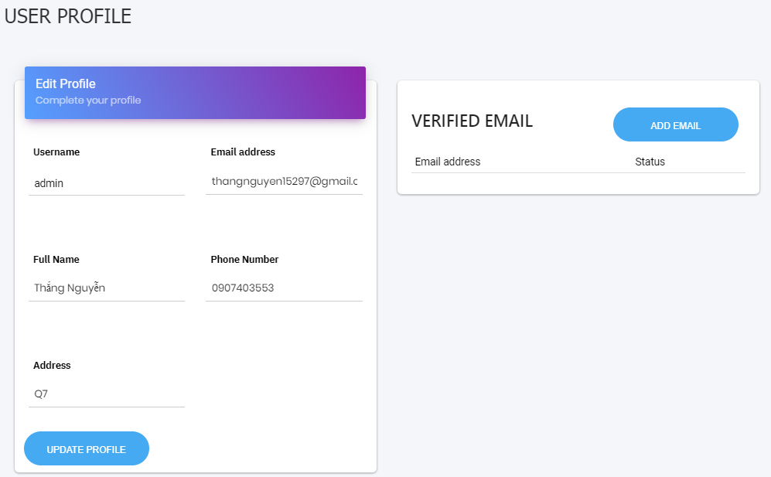





Contact
Add contact
Edit contact
View detail
Move to blacklist

Slide 27
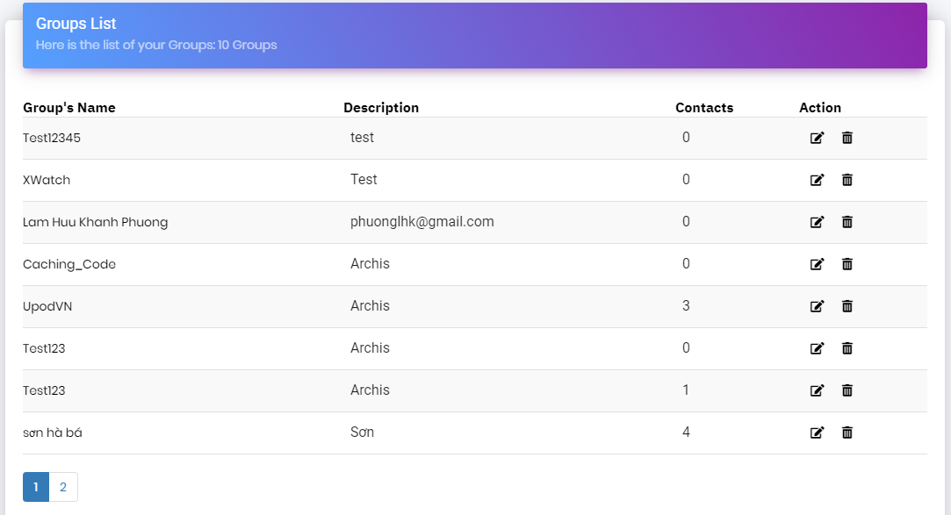
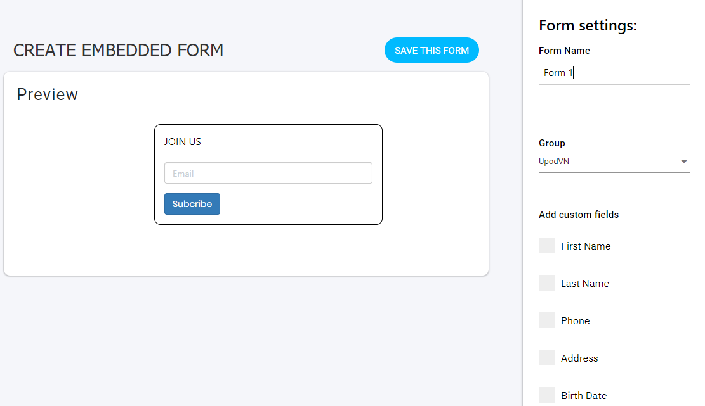
Group contact
Create group
Edit group
View detail
Create segment

Slide 28



User profile
Update profile
Add verify email

Slide 29
Template
Create template
Preview template
Edit template
Copy template

Slide 30
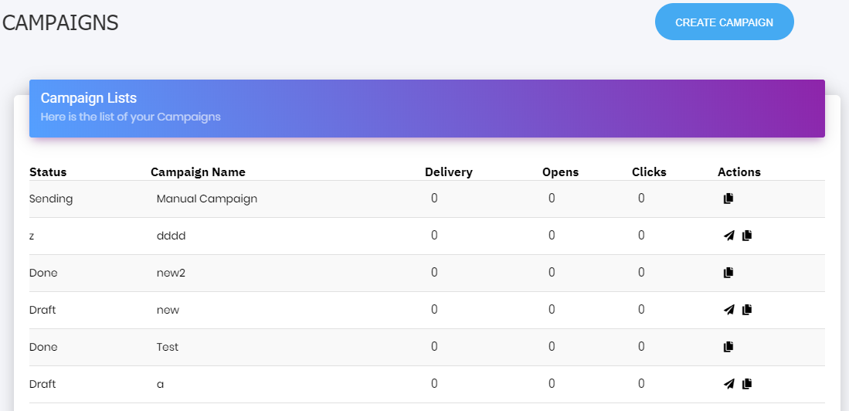
Regular campaign
Create campaign
Edit campaign
View detail
Copy campaign

Slide 31
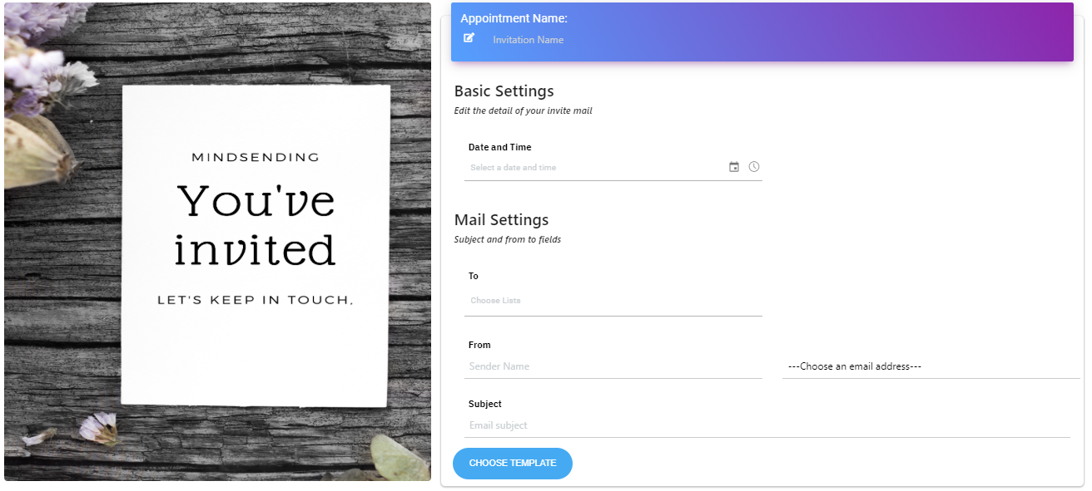
Appointment
Create appointment
Edit appointment
View detail

Slide 32
Embed form
Create form
Copy code
Preview form

Slide 33
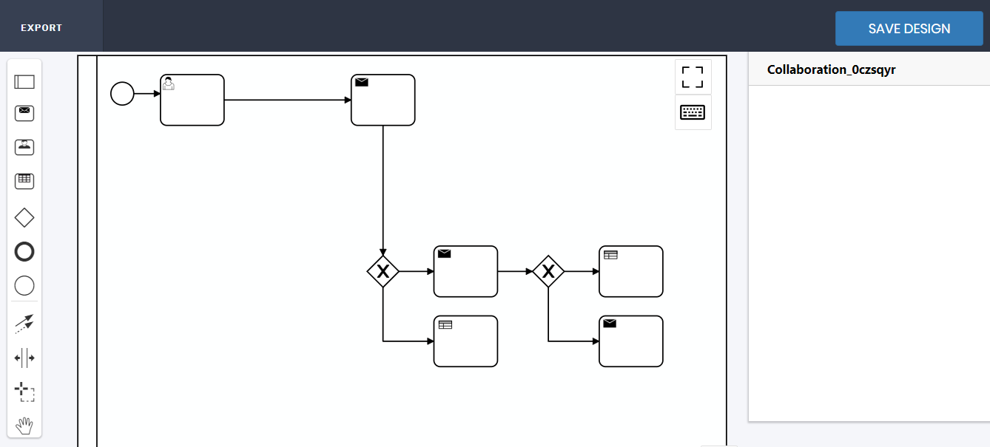
Workflow
Create workflow
View detail

Slide 34
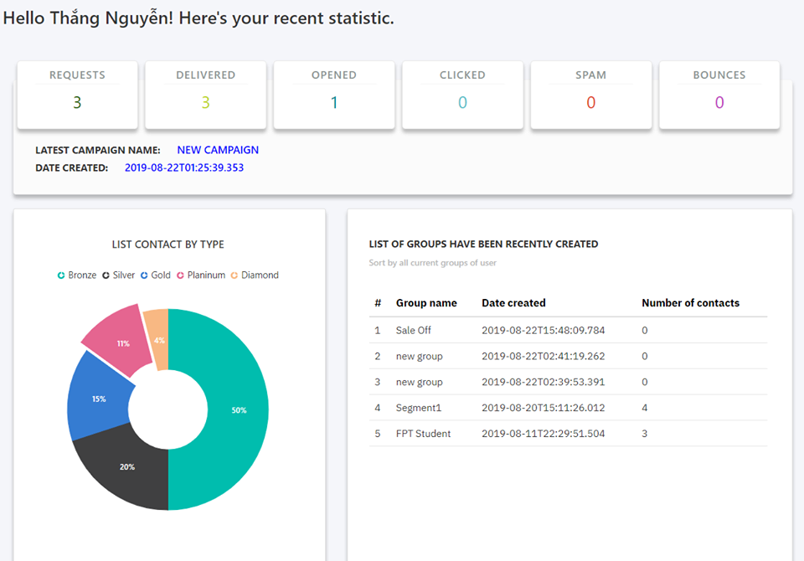
Dashboard
View detail

Slide 35

















4. Outcome

Slide 36













5. Future Plan

Slide 37




Thanks for listening!

Slide 38
Q & A

